Slide 1
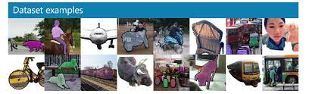
Image Caption Generator with CNN and LSTM
Submitted By :- Mehrunisa Naik

Slide 2
Project synopsis
1. Introduction to the Project
2. Objectives of the Project
3. Flow Chart of operations
4. Python Codes
5. Screenshot of the Outputs
6. Algorithms [CNN, LSTM]
7. Learning Outcomes
8. Conclusion
9. Citations – Books and Websites used for research.

Slide 3
1. Introduction to the Project
Image caption generator is a task that involves computer vision and natural language processing concepts to recognize.
The context of an image and describe them in a natural language like English.

Slide 4
2. Objectives of the Project
Objects are annotated with a bounding box and class label. This annotation can be used to identify what is in an image. In the example below, giraffes and cows are identified in a photo of the outdoors.

Slide 5
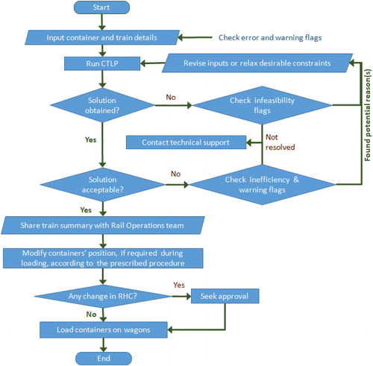
3. Flow Chart of operations

Slide 6
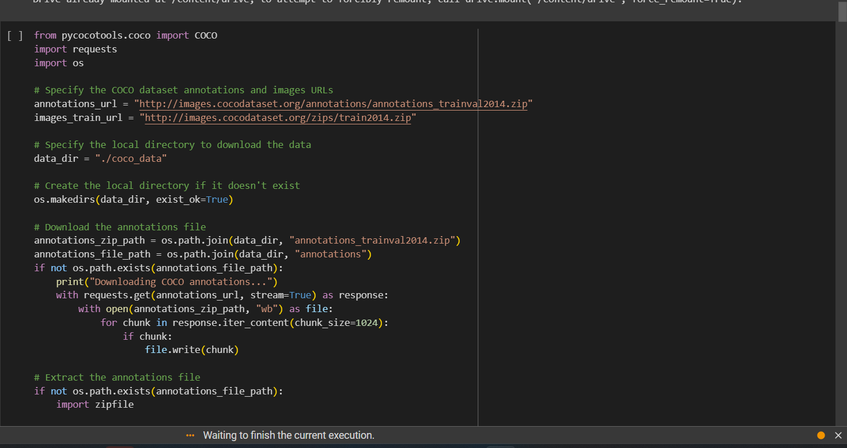
Python Codes

Slide 7
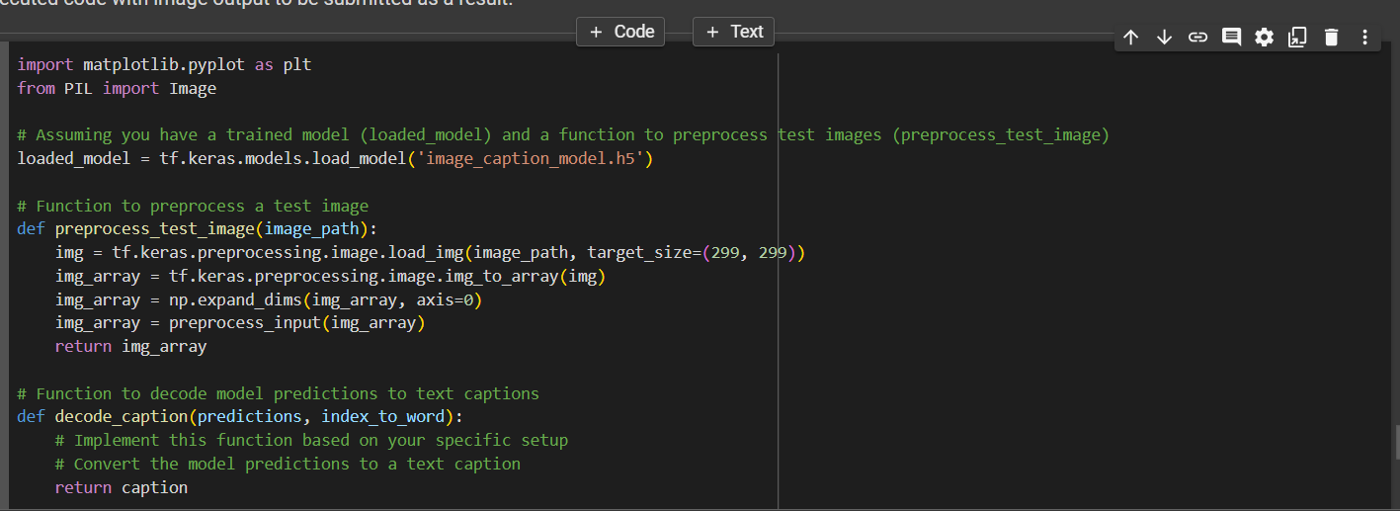
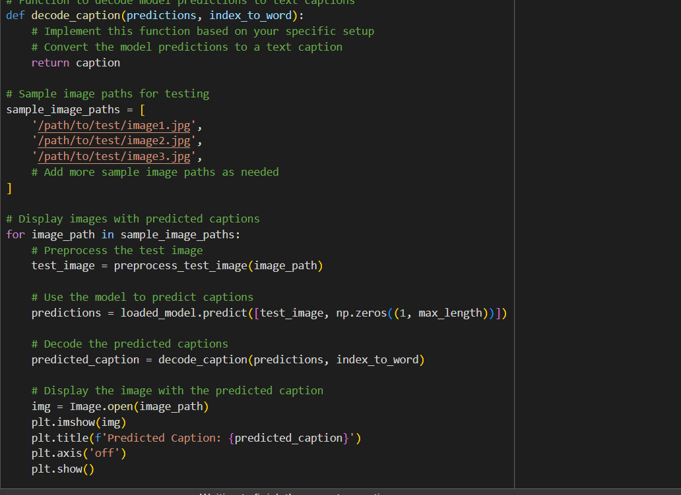

Slide 8
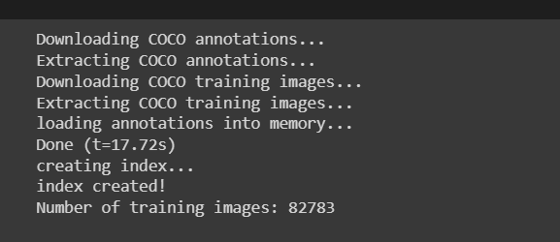
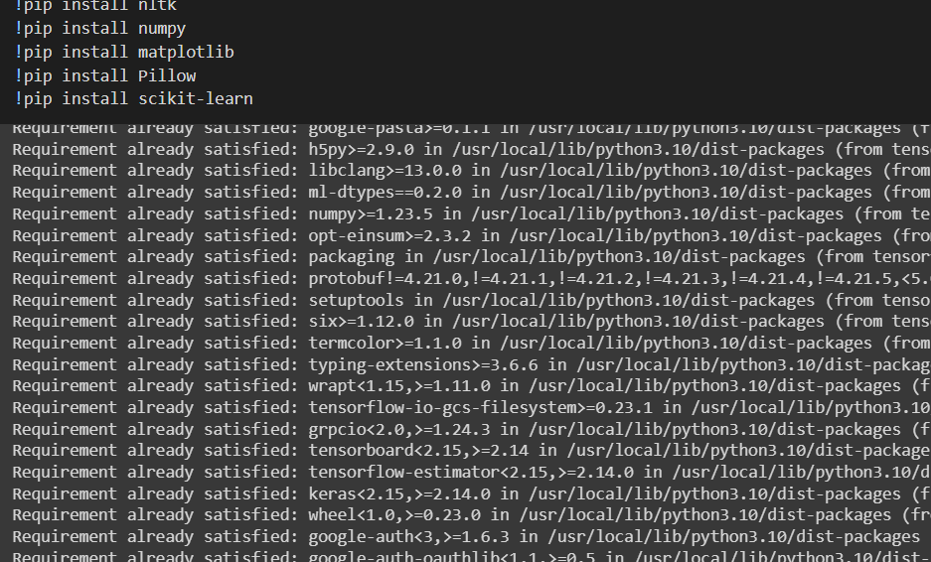
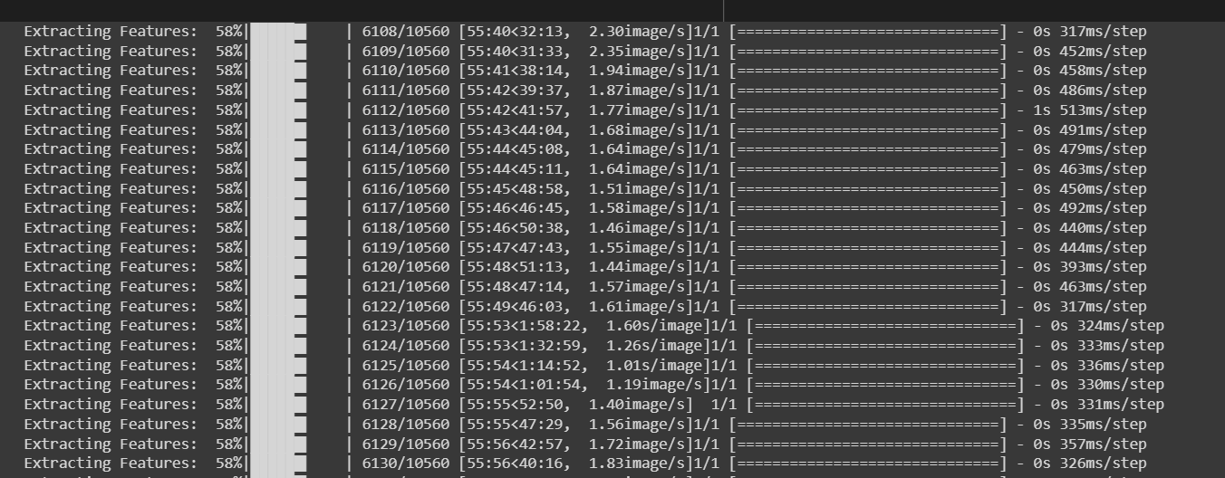
5. Screenshot of the Outputs

Slide 9
6. Algorithms [CNN, LSTM]
Image Caption Generator Model
1
CNN
2
LSTM

Slide 10
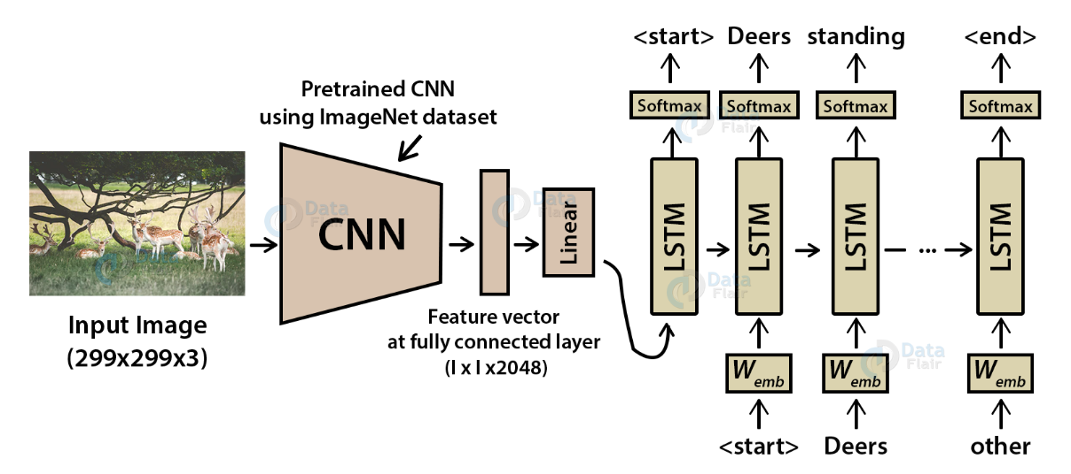
Image Caption Generator Model

Slide 11
What is CNN?
Convolutional Neural networks are specialized deep neural networks which can process the data that has input shape like a 2D matrix. Images are easily represented as a 2D matrix and CNN is very useful in working with images.

Slide 12
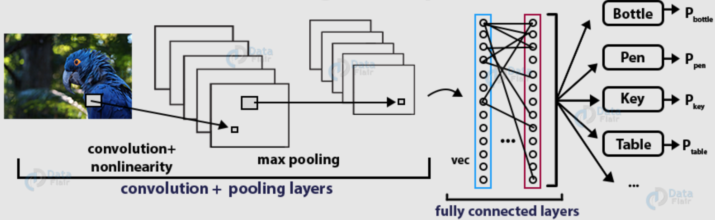
Working on deep CNN

Slide 13
What is LSTM?
LSTM stands for Long short term memory, they are a type of RNN, which is well suited for sequence prediction problems. LSTM can carry out relevant information throughout the processing of inputs and with a forget gate, it discards non-relevant information.

Slide 14
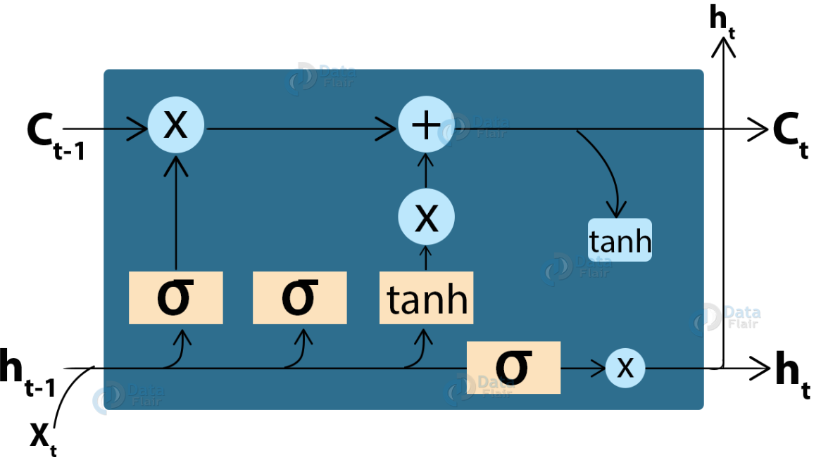
LSTM cell structure

Slide 15
9. Citations – Books and Websites used for research.
GitHub
Google
Kaggle

Slide 16
Conclusion
The CNN-LSTM model was created to generate captions for the input images automatically. This concept can be used in a wide range of situations. You will learn about the CNN and LSTM models, and how to overcome previous limitations in the field of graphical image captioning by building a CNN-LSTM model capable of scanning and extracting information from any input image and transforming it into a single-line sentence in natural language English.

